Slide 1







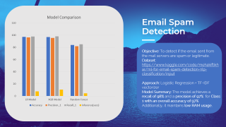


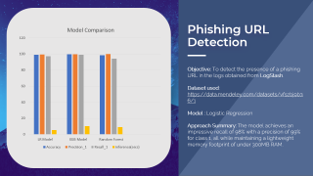

SCROLLING
SLIDE ZOOMS
Notes:
https://duotone.shapefactory.co/?i=-HH3cGeAC4o&f=3fc7ff&t=2c0058&q=_
https://duotone.shapefactory.co/?f=3fc7ff&t=2c0058&q=_

Slide 2

SCROLLING
SLIDE ZOOMS
Notes:
https://duotone.shapefactory.co/?i=-HH3cGeAC4o&f=3fc7ff&t=2c0058&q=_
https://duotone.shapefactory.co/?f=3fc7ff&t=2c0058&q=_

Slide 3
SCROLLING
SLIDE ZOOMS
Notes:
https://duotone.shapefactory.co/?i=-HH3cGeAC4o&f=3fc7ff&t=2c0058&q=_
https://duotone.shapefactory.co/?f=3fc7ff&t=2c0058&q=_

Slide 4
SCROLLING
SLIDE ZOOMS
Notes:
https://duotone.shapefactory.co/?i=-HH3cGeAC4o&f=3fc7ff&t=2c0058&q=_
https://duotone.shapefactory.co/?f=3fc7ff&t=2c0058&q=_

Slide 5
Core
Objectives
To add maximum functionalities and maintain least resource usage
To make it easily deployable in multiple servers
Notes:
https://storyset.com/illustration/meditation/bro
https://duotone.shapefactory.co/?i=-HH3cGeAC4o&f=3fc7ff&t=2c0058&q=_

Slide 6

Approaches
That made a difference
1
2
3
4
Phishing URL
Email Spam
Brute-force
Anomaly
The model classifies the input URLs as Phishing or Benign
The model classifies the input email content as spam or ham.
The model detects brute force attacks in real-time.
The model detects Anomalous behaviour in the system.
Notes:
https://duotone.shapefactory.co/?i=roZgc7SXXmI&f=3fc7ff&t=2c0058&q=_

Slide 7



Phishing URL Detection
Objective: To detect the presence of a phishing URL in the logs obtained from LogStash.
Dataset used: https://data.mendeley.com/datasets/vfszbj9b36/1
Model : Logistic Regression
Approach Summary: The model achieves an impressive recall of 98% with a precision of 99% for class 1, all while maintaining a lightweight memory footprint of under 300MB RAM.
Notes:
https://duotone.shapefactory.co/?i=phIFdC6lA4E&f=3fc7ff&t=2c0058&q=_

Slide 8
The Approach
Loaded the dataset and feature engineered multiple features such as character counts, entropy, digit/uppercase ratios, suspicious words, and boolean indicators.
Applied SMOTE to balance the classes after splitting the data into train and test sets.
Scaled features using StandardScaler.
Trained and evaluated models including Logistic Regression, Random Forest, and XGBoost.
Logged models and metrics to MLflow/DagsHub for experiment tracking
Notes:
https://duotone.shapefactory.co/?i=phIFdC6lA4E&f=3fc7ff&t=2c0058&q=_

Slide 9
Email Spam
Detection
Objective: To detect if the email sent from the mail servers are spam or legitimate.
Dataset: https://www.kaggle.com/code/mehakiftikhar/ml-for-email-spam-detection-nlp-classification/input
Approach: Logistic Regression + TF-IDF vectorizer
Model Summary: The model achieves a recall of 98% and a precision of 97% for Class 1 with an overall accuracy of 97%. Additionally, it maintains low RAM usage,

Slide 10
The Approach
Kunnaaaaaaaaaaaaaaaaaaaaaaaaaaaaaaaaa
Adfsdf
Dafsdfds
Asfasd
Notes:
https://duotone.shapefactory.co/?i=phIFdC6lA4E&f=3fc7ff&t=2c0058&q=_

Slide 11
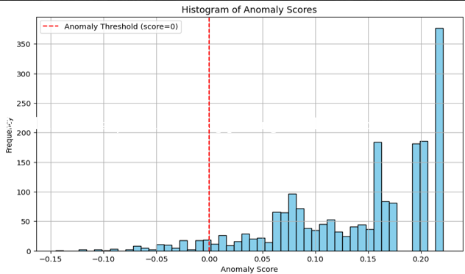
Brute-force &
Unauthorized Package Detection
Objective: To train an unsupervised model to detect and flag suspicious activity (e.g., brute-force attempts, unauthorized installs.
Dataset: Uses Synthetic logs(web_auth logs, mail_login logs) generated using the default log patterns.
Model : Isolation Forest
Approach Summary: Real time log parsing and
Brute-force Detection accompanied by the detection of Unauthorized package installations.
Distribution of anomaly scores assigned by the Isolation forest model
Notes:
https://duotone.shapefactory.co/?i=phIFdC6lA4E&f=3fc7ff&t=2c0058&q=_

Slide 12
Anomaly Detection (Postfix)
Objective: To detect logs that exhibit outlier properties in real time.
Dataset: ~2000 Postfix and RoundCube log entries obtained from the kafka stream.
Model: Isolation Forest
Approach Summary: Logs from the Kafka stream are parsed and feature-engineered in real time before being fed into the model for detection and alert generation.

Slide 13


GLASSMORPHIC
CHARTS
Notes:
https://storyset.com/illustration/business-plan/bro
https://duotone.shapefactory.co/?i=c65n6pgkXkI&f=3fc7ff&t=2c0058&q=_

